Slide 1
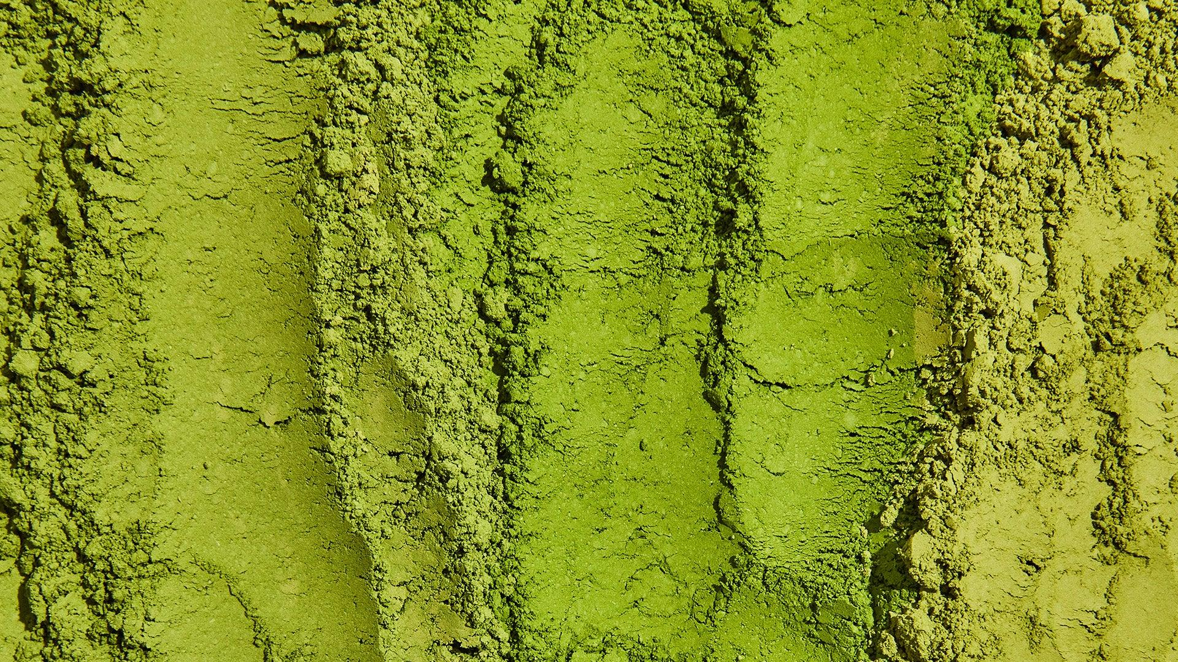
MapMyMatcha

Slide 2

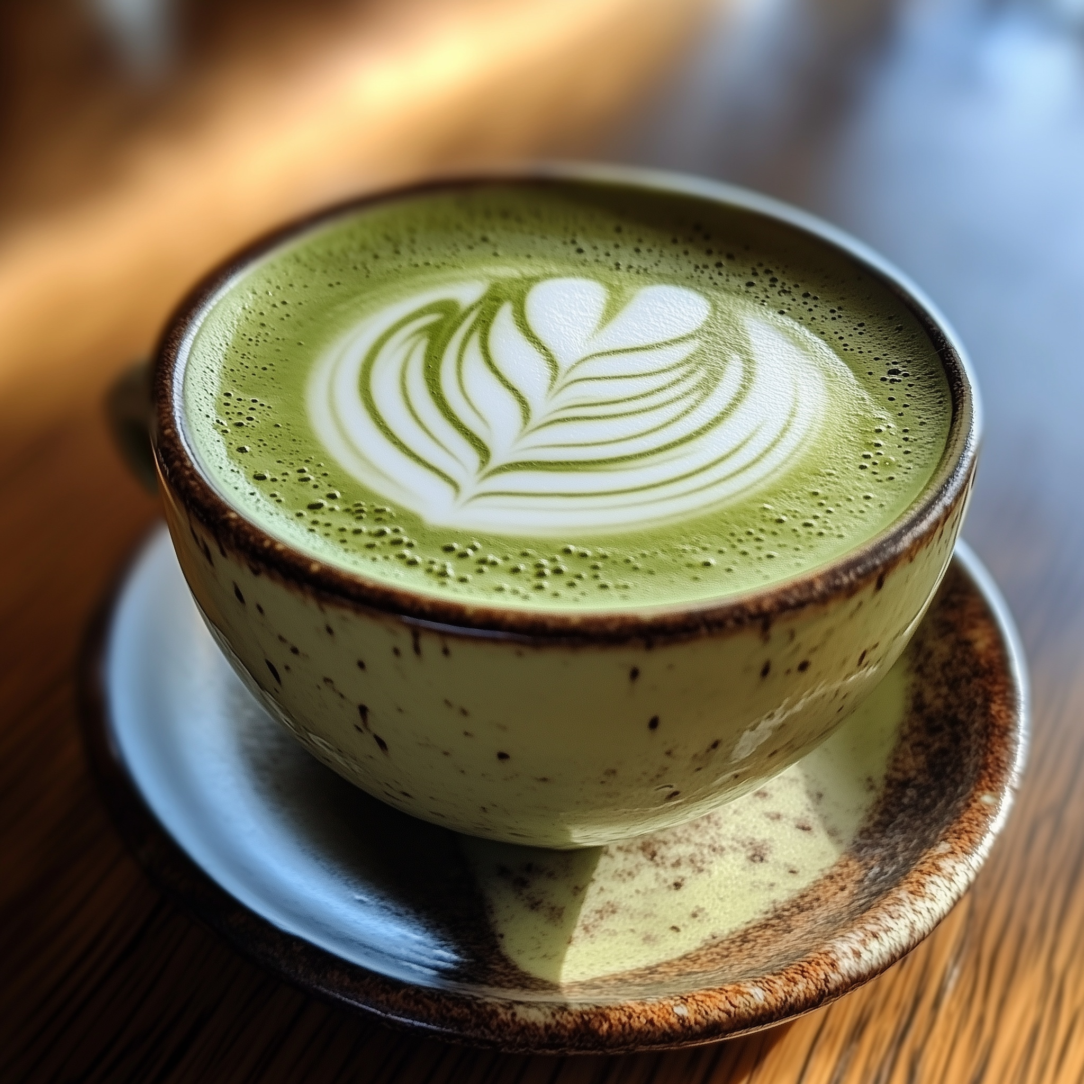
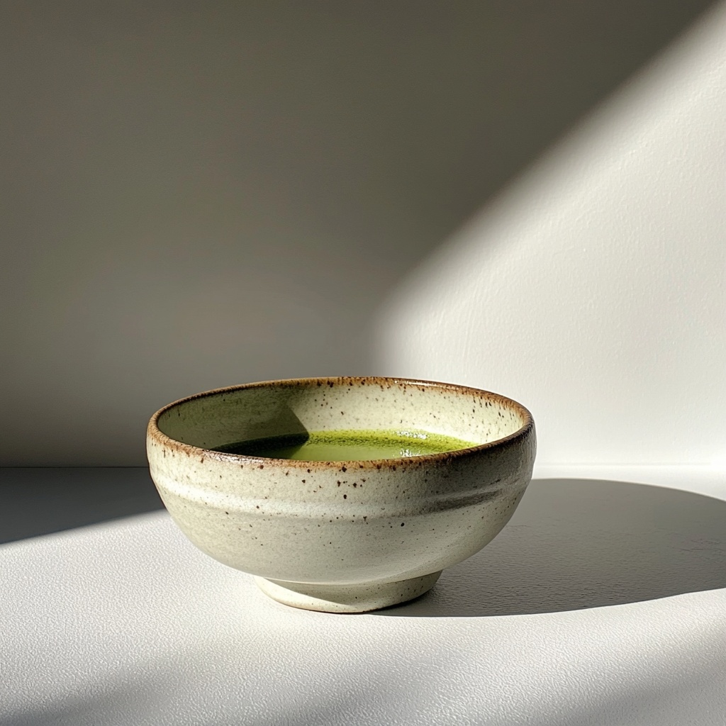
The page opens with a vibrant, steaming cup of fresh matcha at the center, drawing viewers in with its warmth. As steam gently rises, it transforms into the brand logo, elegantly floating above the cup. Below the mug, two buttons appear, offering options to "Sign Up" or "Log In."

Slide 3
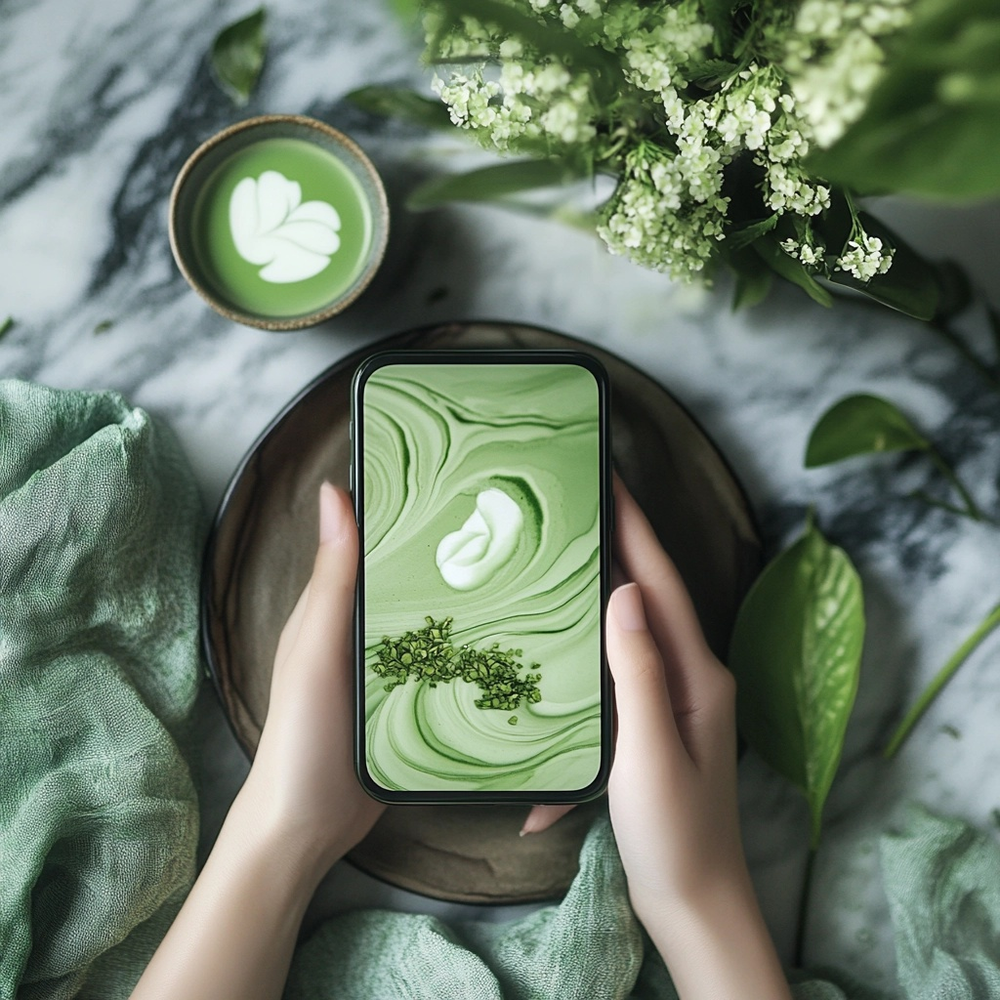
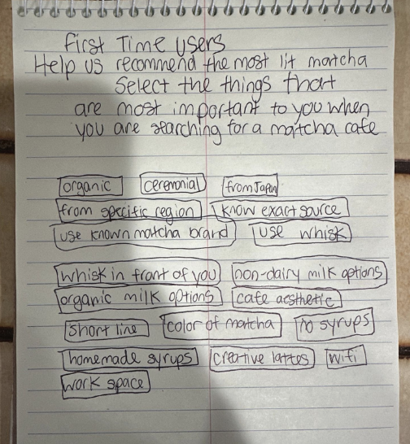
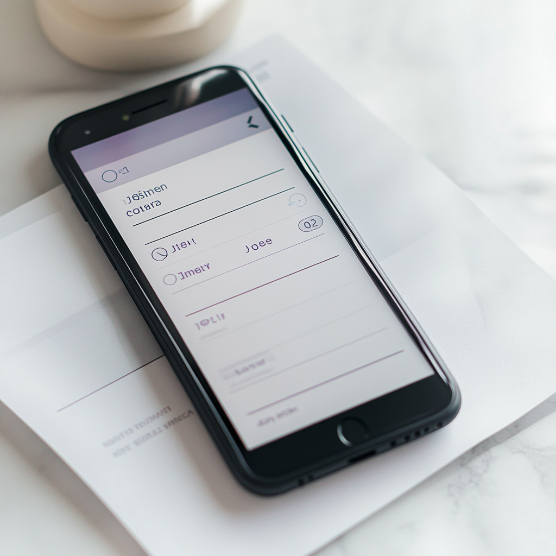
First-time users are guided to a brief survey that gathers their top preferences for finding the perfect matcha experience at a café. The survey theme is simple and elegant, supported by the matcha green color. The screen is populated with the various tags, to which users can select their preferences with ease and simplicity.
TAGS: organic, ceremonial, from Japan, known farm/source, use whisk, whisked in front of you, non-dairy milk, seed oil-free milk, short lines, color, unsweetened, creative lattes, wifi, homemade syrups, work space, organic milk, use specific brand, price point, etc.

Slide 4
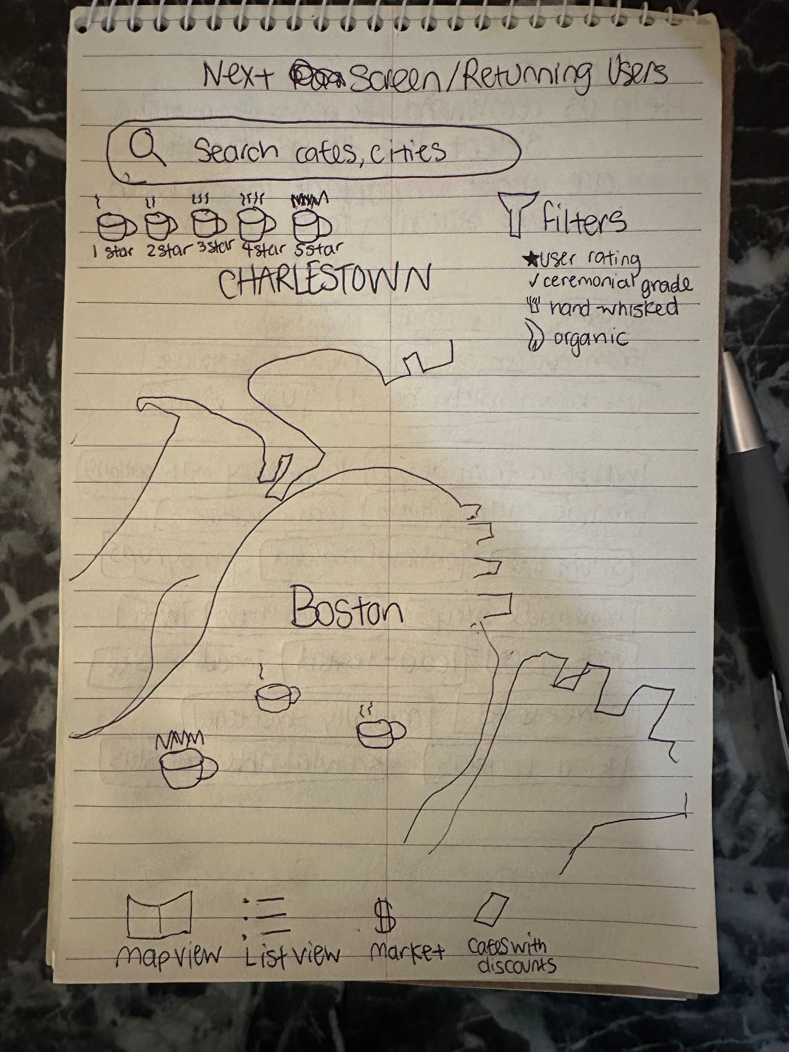
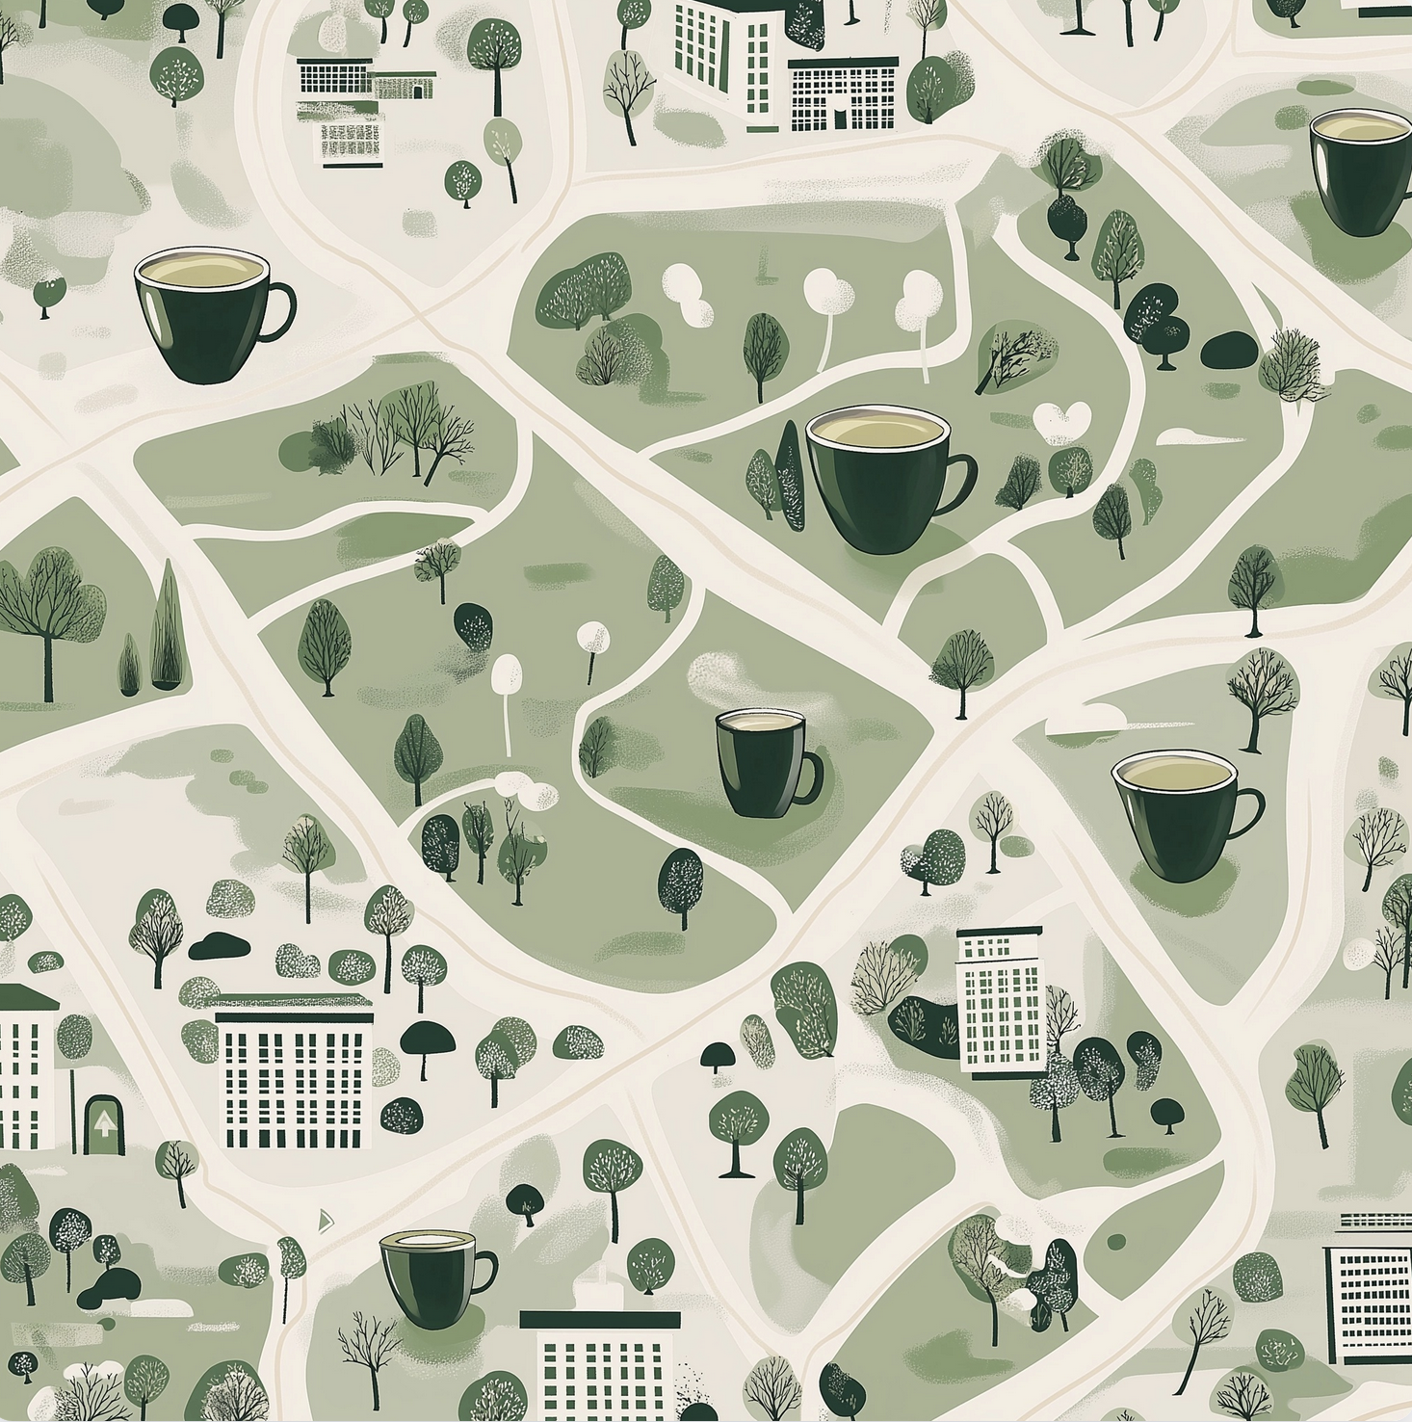
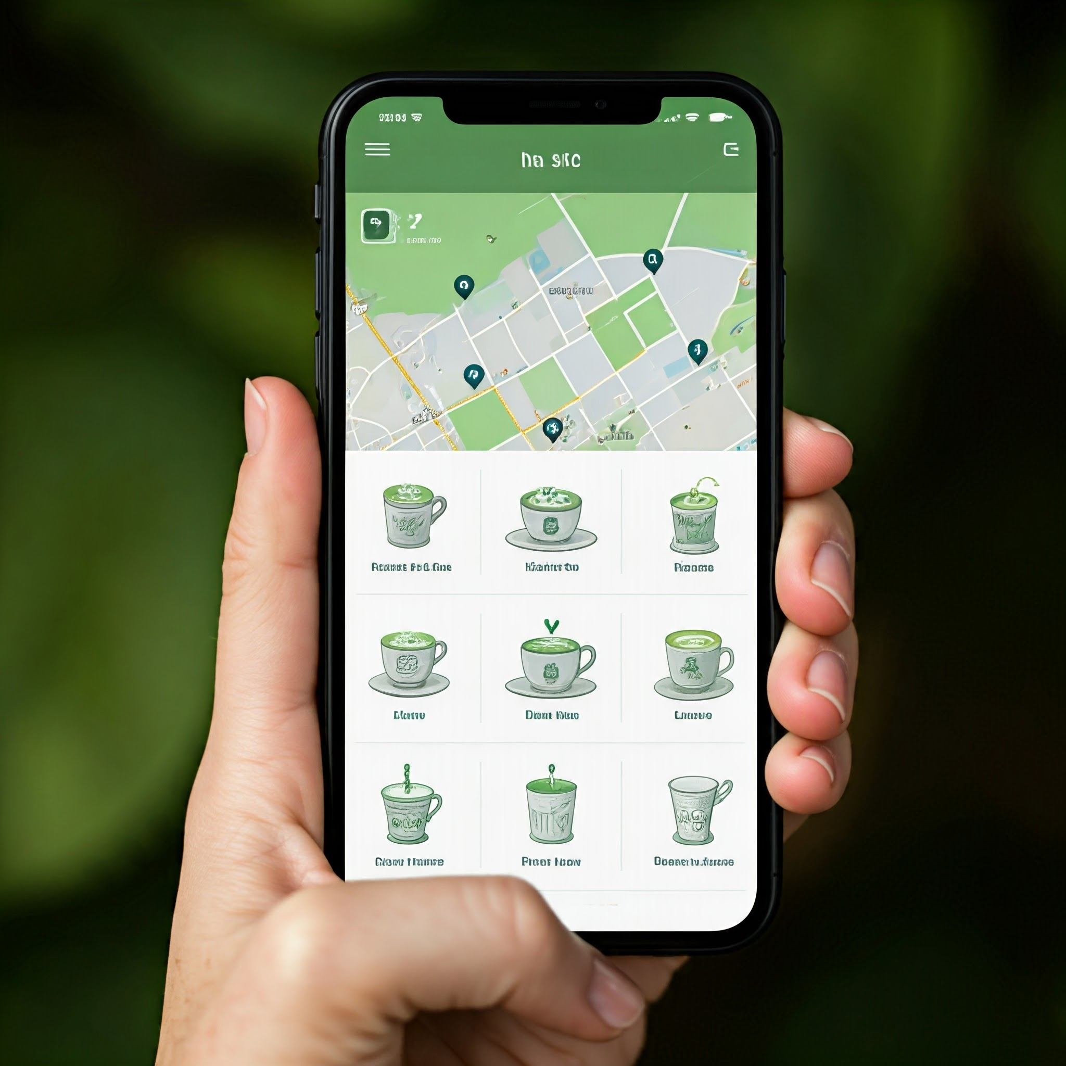
Welcome to the ultimate matcha journey, where you'll be immersed in an unparalleled matcha experience. Discover the top-rated matcha cafés across the country, right at your fingertips, anytime and anywhere. Filter by rating, ceremonial, organic.

Slide 5
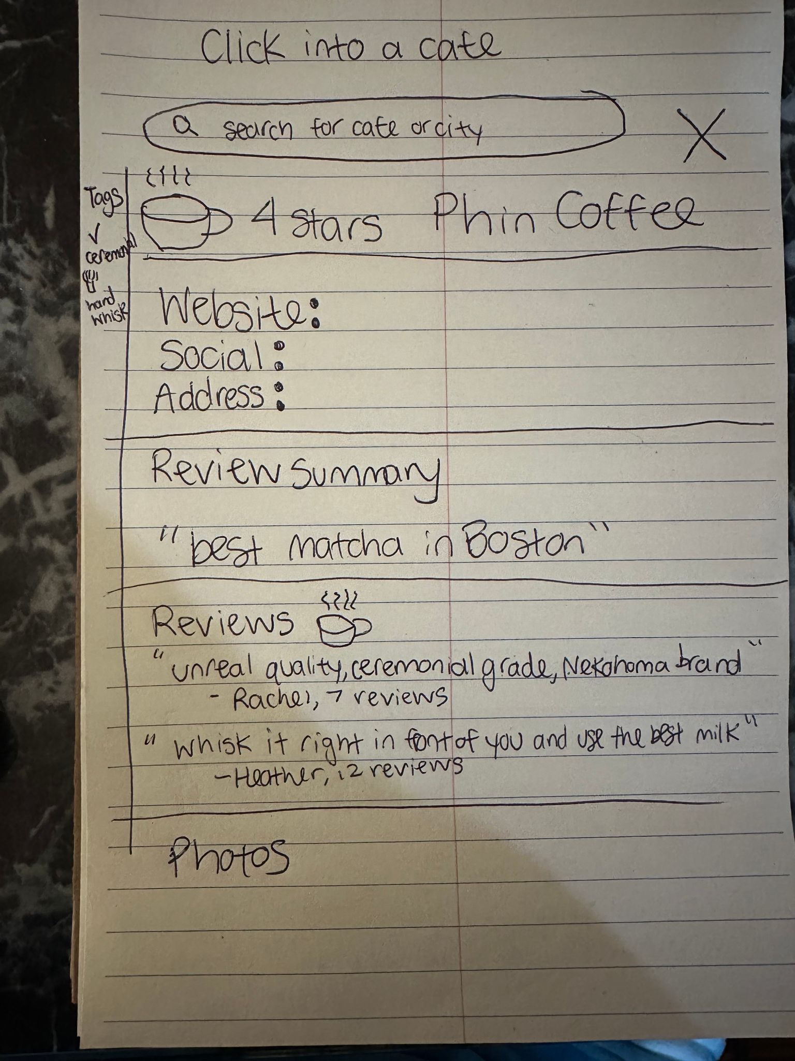

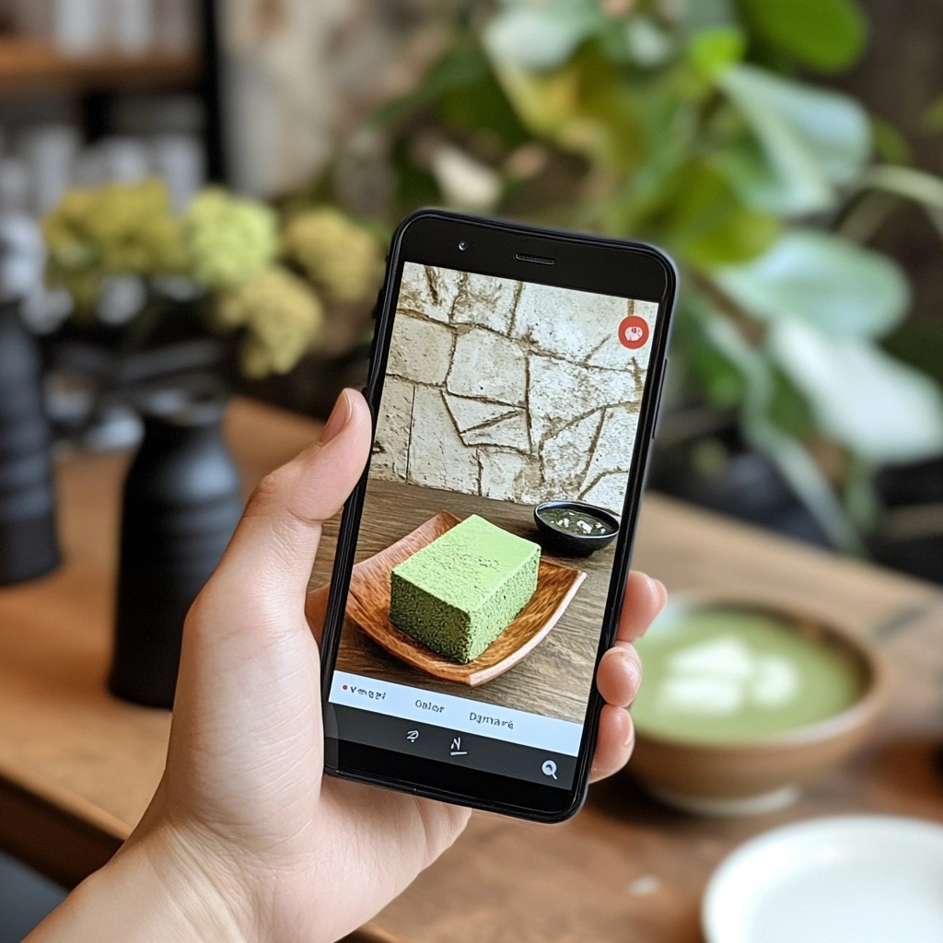
Step into a café's profile and unlock a treasure trove of insights to find your perfect matcha destination. Discover detailed ratings, essential café information, vibrant community discussions, and authentic photos from fellow matcha lovers. After experiencing it yourself, join the conversation and share your own perspective.

